Slide 1
IIIT BHAGALPUR
ARTIFICIAL INTELLIGENCE
Course No- CS303
INSTRUCTOR-Mr. RUPAM BHATTACHARYYA

Slide 2
ASSIGNMENT ID- 08
This assignment wishes to send the user from Arad to Bucharest in the map of Romania using the Greedy Best First Search with the Straight line distance to reach Bucharest as the Heuristic Function for the Problem.
GROUP ID - 05
GROUP MEMBERS -
AMAN MISHRA CSE 170101008
MD. ASHIF REZA CSE 170101023
SURAJ KUMAR CSE 170101053
RASHI KRISHNA CSE 170102037
GUNJAN KUMARI ECE 170102018
SUBMISSION DATE – 20/09/2019

Slide 3
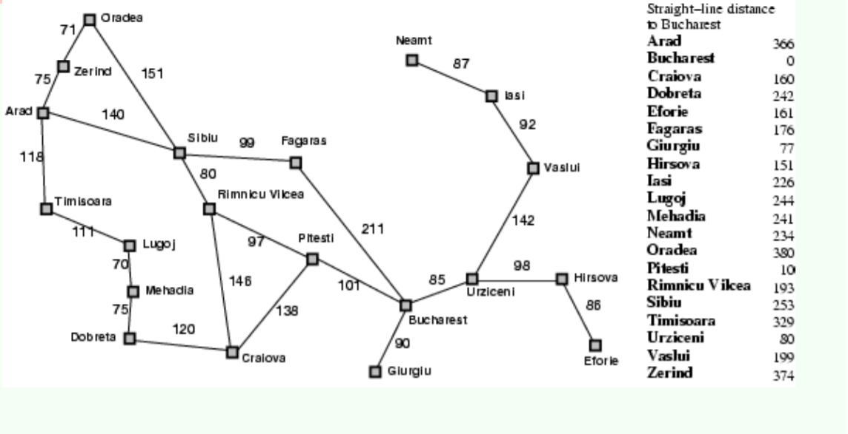
PROBLEM
Figure shows the map of ROMANIA and starting state of your agent is Arad .Your agent must reach Bucharest.

Slide 4
The heuristic function h(n) is the straight line distances to reach Bucharest. Your agent should solve the above problem using Greedy Best First Search algorithm . Utilize C/C++ programming language to implement your agent.
Understanding the Problem
Here we have to move from Arad to Bucharest, for this we have to calculate the shortest path between Arad and Bucharest using Greedy Best First Search Algorithm.

Slide 5
Greedy Best First Search Algorithm
Greedy best-first search tries to expand the node that is closest to the goal, on the grounds that this is likely to lead to a solution quickly. Thus, it evaluates nodes by using just the heuristic function; that is, f(n)=h(n).
It expands the node that is estimated to be closest to goal .
It completely ignores g(n) i.e. the cost to get to n .

Slide 6
Flow Chart
Start
Take an initial point
Set current point=initial_point and set visited [current_point]=1
If visited [dest_pt]!=1
End
No
Yes

Slide 7
Find paths from current point.
Select city which has least distance to Bucharest.
Update current point and set visited[cur_pt]=1
Print current point and its distance to Bucharest.

Slide 8
Code
#include<stdio.h> #include<string.h>
int path[20][20];
int dist_bucharest[20]; int visited[20];
int availables[10][2];
char *name[20]={"Arad", "Bucharest" , "Craiova", "Dobreta", "Eforie", "Fagarus",
"Giurgiu", "hirsova", "Lasi", "Lugoj", "Mehadia", "Neamt", "Oradea", "Pitesti",
"RimnicuVilcea", "Sibeu", "Timisora", "Urziceni", "Valsui", "Zerind"};
void create_map() {
for (int i = 0; i < 20; i++)
for (int j = 0; j < 20; j++) {
path[i][j] = 20000;
path[i][i] = 0;
}

Slide 9
path[0][15] = 140;
path[0][19] = 75;
path[0][16] = 118;
path[1][5] = 211;
path[1][6] = 90;
path[1][13] = 101;
path[1][17] = 85;
path[2][3] = 120;
path[2][13] = 138;
path[2][14] = 146;
path[3][10] = 75;
path[4][7] = 86;
path[5][15] = 99;
path[7][17] = 98;
path[8][11] = 87;
path[8][18] = 92;
path[9][10] = 70;
path[9][16] = 111;
path[12][19] = 71;
path[12][15] = 151;
path[14][15] = 80;
path[14][13] = 97;
path[17][18] = 142;

Slide 10
for(int i=0; i<20; i++)
for(int j=0; j<20; j++)
path[j][i]= path[i][j];
dist_bucharest[0]=366;
dist_bucharest[1]=0;
dist_bucharest[2]=160;
dist_bucharest[3]=242;
dist_bucharest[4]=161;
dist_bucharest[5]=176;
dist_bucharest[6]=77;
dist_bucharest[7]=151;
dist_bucharest[8]=226;
dist_bucharest[9]=244;
dist_bucharest[10]=241;
dist_bucharest[11]=234;
dist_bucharest[12]=380;
dist_bucharest[13]=100;
dist_bucharest[14]=193;
dist_bucharest[15]=253;
dist_bucharest[16]=329;
dist_bucharest[17]=80;
dist_bucharest[18]=199;
dist_bucharest[19]=374;
for(int i=0;i<20; i++)
visited[i] = 0;
}

Slide 11
int minimum(int arr[][2], int n) {
int mincount = 0;
int min = 9999;
for (int i = 0; i < n; i++) {
if (arr[i][1] < min) {
min = arr[i][1];
mincount = arr[i][0];
}
}
return mincount;
}
int main() {
create_map();
printf("List of States..\n");
for (int i = 0; i < 20; i++) {
printf("%s\n", name[i]);
}
for (int i = 0; i < 10; i++) {
availables[i][1] = 2000;
availables[i][0] = 99;
}

Slide 12
int steps=0;
Char init[10],dest[10];
Int initpoint,destpoint,currpoint,minpoint, i=0,j=0,k=0;
printf("\nEnter the Initial Place: ");
scanf("%s", & init);
strcpy(dest, "Bucharest");
for (i = 0; i < 20; i++) {
if (strcmp(name[i], init) == 0)
initpoint = i;
if (strcmp(name[i], dest) == 0)
destpoint = i;
}
visited[initpoint] = 1;
currpoint = initpoint;
printf("\nStarting.. Greedy BFS for the Map of Romania!\n\nSt. Line
Distance from Bucharest\ tState(Node)\ n ");

Slide 13
while (visited[destpoint] != 1) {
k = 0;
for (j = 0; j < 20; j++) {
if (path[currpoint][j] < 20000 && path[currpoint][j] > 0 && visited[j] != 1)
{
availables[k][0] = j;
availables[k][1] = dist_bucharest[j];
k++;
}
}
printf("%d\t\t\t\t\t%s\n", dist_bucharest[currpoint], name[currpoint]);
minpoint = minimum(availables, k);
visited[currpoint] = 1;
steps++;
currpoint = minpoint;
}
printf("Total no of Steps=%d\n", steps - 1);
return 0;
}

Slide 14
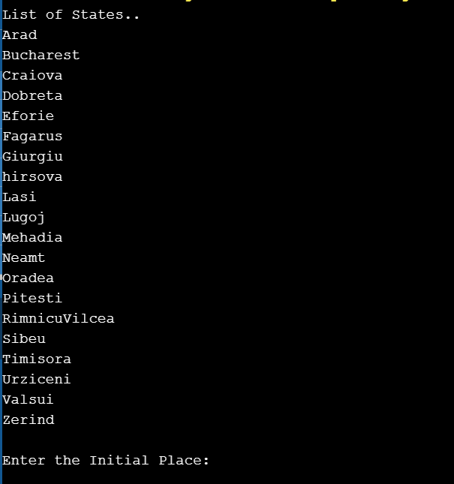
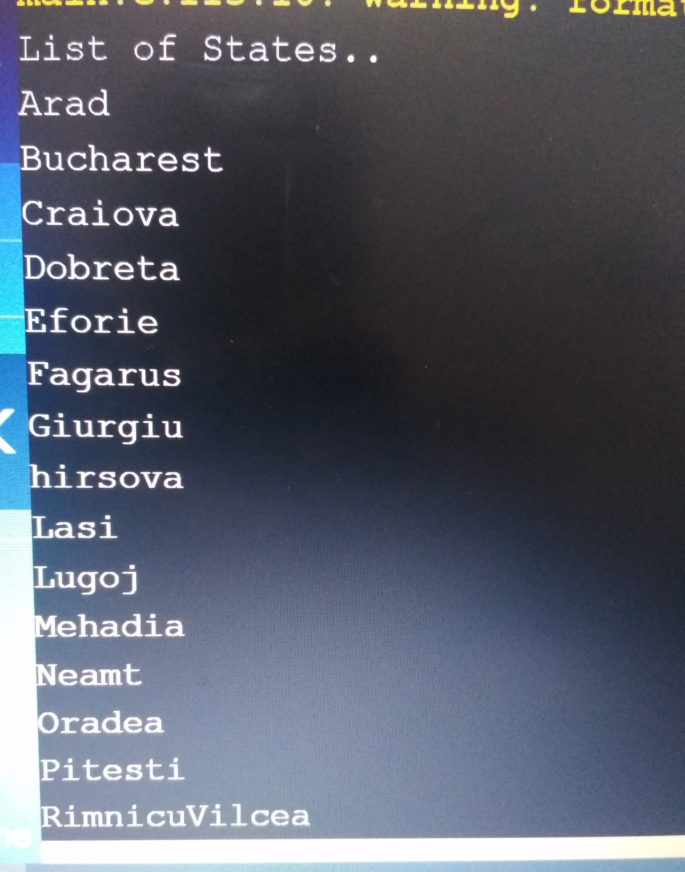
OUTPUT

Slide 15
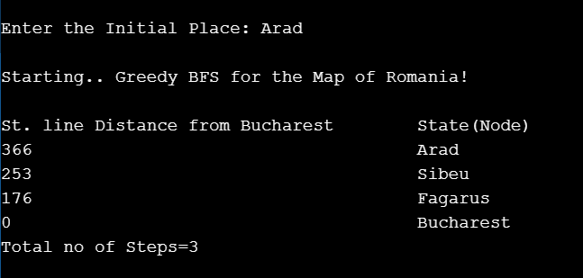

Slide 16
Observations
We found that the Greedy Best First Search is not giving an optimal solution to the problem provided.
At times, it covers more distance than the optimal distance to reach Bucharest (Destination).
The heuristic function taken considers only the straight line distance from Bucharest and goes to the next state irrespective of how much distance it has to travel from the current node to the next node [g(n)].
If we travel from some other state to Bucharest, it may give the optimal Solution.

Slide 17
CONCLUSION
Time complexity of Greedy BFS is O(b^m) ,
m->depth of tree , b->branch factor
It does not provide optimal solution.
It is more efficient than that of Bredth First Search and Depth First Search.

